Slide 1
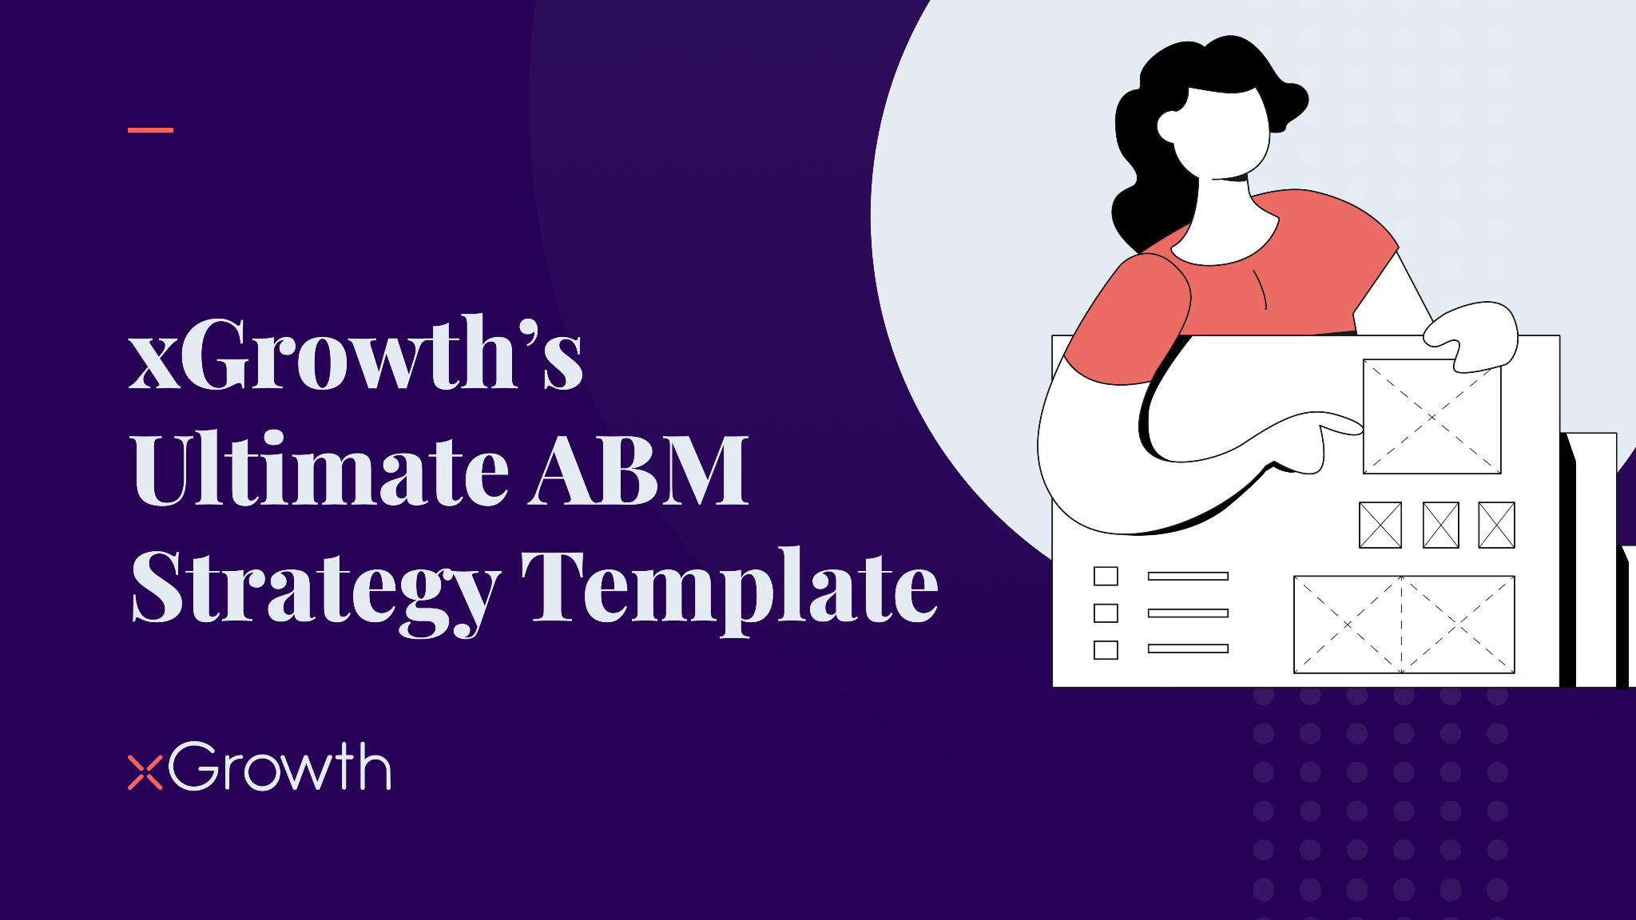

Slide 2
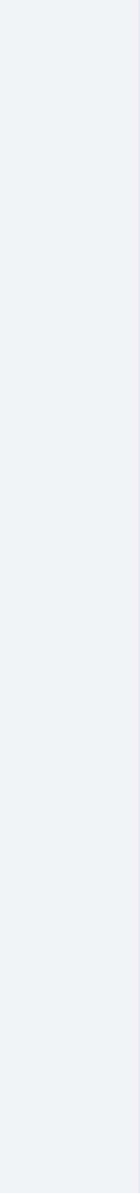

© 2023 xGrowth Pty Ltd. All Rights Reserved
How to best use this template…
Hello There! Thanks for downloading this ABM Strategy Template. Here are a few items to take note of before diving in!
To access the editable version of this template, please "make its copy" using the "File" menu on your top left. You can also download it as a PowerPoint.
Ensure that you have read the article on our website through which you downloaded this template. The article provides additional commentary on each of the slides.
In specific slides, we have presented some dummy data from the perspective of a CRM company selling to B2B/B2C organisations. For more specificity, a CRM company selling its software to organisations in the banking sector.
Examples of CRM companies could be Salesforce, HubSpot et cetera.
Remember, while we have kept this template exhaustive based on industry best practices and our experience as a specialised B2B ABM agency, don’t hesitate to change this template as per your needs and make it your own.
Have feedback for us? - Send it to hello@xgrowth.com.au
Want more details or a discovery session on how we can help you ace your ABM journey? - Contact us here
The Ultimate ABM Strategy Template

Slide 3

© 2023 xGrowth Pty Ltd. All Rights Reserved
What’s in this template…
ABM Ideal Customer Profile
ABM Account List & Prioritisation
ABM Segmentation
ABM Buying Centres Identification
ABM Account Intelligence
ABM Core Team (RACI Matrix)
ABM Budget Planning
ABM Sales Alignment Checklist
ABM Campaign Project Plan
ABM Metrics
The Ultimate ABM Strategy Template

Slide 4
© 2023 xGrowth Pty Ltd. All Rights Reserved
ABM Ideal Customer Profile
Be as specific as possible with your ICP!
Number of Employees* Revenue* Example: Number of employees More than 500, at least 20% being software developers Revenue More than $30 million in annual recurring revenue with most of it coming from small B2C customers | Industry* Geography* Example: Industry Financial Services, more specifically, large and medium sized banks. Large and medium sized insurance companies Geography Singapore, Australia (Melbourne, Sydney), India (Bangalore, Hyderabad, Mumbai)
Pain Points* Example: Not able to compete with digital players Customer experience is not smooth Looking to prevent end customer churn | Buying Process* Example: Target account should not have more than 6 decision makers Target account should have an official tender process
The Ultimate ABM Strategy Template
*There could be more parameters used to etch out the ICP apart from the mentioned ones, but these are typically the common ones!
This table has dummy data & information

Slide 5
© 2023 xGrowth Pty Ltd. All Rights Reserved
ABM Account List & Prioritisation
Prioritisation Parameters | ICP Fit % (0-10) | Current Need (0-10) | Opp. Revenue (0-10) | Decision Maker Inclination (0-10) | Buying History (0-10) | Overall Prioritisation Score (0-10) | Rank
Weightage | 20% | 25% | 15% | 25% | 15% | Weighted Avg. | #
Account A | 5 | 0 | 1 | 1 | 0 | 0.7 | 7
Account B | 9 | 8 | 7 | 3 | 5 | 6.35 | 5
Account C | 7 | 4 | 6 | 5 | 7 | 5.6 | 6
Account D | 6 | 8 | 6 | 6 | 8 | 6.8 | 4
Account E | 5 | 9 | 7 | 7 | 8 | 7.25 | 3
Account F | 10 | 10 | 8 | 8 | 7 | 8.75 | 2
Account G | 8 | 5 | 7 | 8 | 6 | 6.8 | 4
Account H | 10 | 10 | 10 | 10 | 10 | 10 | 1
The Ultimate ABM Strategy Template
This table has dummy data & information

Slide 6
© 2023 xGrowth Pty Ltd. All Rights Reserved
ABM Segmentation
ABM Segmentation & corresponding activities | Priority Rank | Size / Annual Revenue (Million $) | Size of ACV (1000 $) | Sales Cycle complexity | ABM Tier (Based on Revenue & ACV) | Applicable Activities
Measuring Range | Refer “ABM List and Prioritisation” template |  |  | (Complex, Medium, Simple) |  | Bespoke Campaigns | Event Invites | Outbound SDR | Digital Ads/Email
Account 1 |  | 2000 | 200 | Complex | 1:1 | Y | Y | Y | Y
Account 2 |  | 100 | 100 | Medium | 1: few | Y | Y | Y | Y
Account 3 |  | 200 | 20 | Simple | 1:many | N | N | Y | Y
Account 4 |  | 120 | 60 | Simple | 1:many | N | N | Y | Y
Account 5 |  | 3000 | 500 | Complex | 1:1 | Y | Y | Y | Y
Account 6
Account 7
Account 8
The Ultimate ABM Strategy Template
This table has dummy data & information

Slide 7
© 2023 xGrowth Pty Ltd. All Rights Reserved
ABM Buying Centres Identification
Buying Center | Key People | Pain Points | Motivations | Metrics they care about | Influenced by
Procurement | Procurement*** Director Supply Chain** Operations Manager Procurement* Analyst | Example > Want to ensure best of breed vendors. | Example > Price of the solution | Example > ROI > Costs saved > Productivity | Example >Word of mouth >Analysts (Gartner) > IT
IT | VP, IT | Example >Lack of tech. resources | Example > Doesn’t want too much disruption on existing systems | Example >Time to launch | Example > Analysts > Procurement
Operations
Marketing
Finance & HR
The Ultimate ABM Strategy Template
Legend for mood and inclination: 1) Adopter/Champion | 2) Neutral | 3) Blocker
Legend for level of Importance: 1) *** - High Influence | 2) ** - Medium Influence | 3) * Low Influence
This table has dummy data & information

Slide 8
© 2023 xGrowth Pty Ltd. All Rights Reserved
ABM Account Intelligence
Account Name: ABC Pte. | Employees: ~5000 | Latest Revenue : $35mil | Headquarters : Singapore Locations: India, ANZ | Industry: Financial Services | Key Competitors: ZYS Bank RET Pte. | Tech. SaaS Budget $200K
Key Employees Relevant: CMO, Marketing Director etc. These would people lie in one your buyer personas) |  | Past Opportunities: Summary of any past communications with the target account |  | Top Industry Trends impacting your target account Trend 1 Trend 2 Trend 3
Incumbent Competing Vendors |  |  |  | Technology landscape Other tech. applications in the company
Strategic Objective/ Pain Point 1 From Annual Report, Social or AE |  |  | Alignment with strategic objective 1 How does your solution help ABC Pte. achieve strategic objective 1
Strategic Objective/Pain Point 2 From Annual Report, Social or AE |  |  | Alignment with strategic objective 2 How does your solution help ABC Pte. achieve strategic objective 2
Strategic Objective/ Pain Point 3 From Annual Report, Social or AE |  |  | Alignment with strategic objective 3 How does your solution help ABC Pte. achieve strategic objective 3
Last Status - Last activity in the account. Example - CMO was sent a direct mail package as a part of the ABM campaign Next Step - Next action item. Example - SDR to call the CMO and follow up for a meeting
The Ultimate ABM Strategy Template
This table has dummy data & information

Slide 9
© 2023 xGrowth Pty Ltd. All Rights Reserved
ABM Core Team Template (RACI Matrix)
FILL NAME —>
ABM Strategy -Key Responsibilities | ABM exec. sponsor | ABM lead | Marketing Manager | Product Marketing | Sales Development | Account Executive | Sales & Marketing Operations Analyst
ABM Budget Creation & Adherence | A | R | C | C | C | C | I
Ideal Customer Profile Development | I | A | R | C | R | R | I
Account List Creation | I | A | R | C | C | R | I
Developing Buyer Persona | I | A | R | C | C | R | I
Gather Data on Target Accounts | I | I | A | C | C | C | R
Develop Messaging | I | A | R | C | R | R | I
Campaign Orchestration | I | C | A | C | R | R | R
Reporting on Results & ABM Metrics | I | C | A | I | I | I | R
The Ultimate ABM Strategy Template
Legend: 1) R - Responsible 2) A - Accountable 3) Consulted 4) Informed
This table has dummy data & information

Slide 10
© 2023 xGrowth Pty Ltd. All Rights Reserved
ABM Budget Projections
Months |  |  |  | Jan | Feb | Mar | Apr | May | Jun
Expense Items | Annual Budget Allocation | Consumption YTD | Budget Left YTD
Staff Salaries
External ABM Consultant Charges
ABM Trainings
Vertical Account Research
Account & Cluster Messaging Development
Web Development
Content Creation
Events, Roundtables & Webinar
Direct mail
Digital Ads
MarTech
Sales Engagement Platform
TOTAL
The Ultimate ABM Strategy Template
This table has dummy data & information

Slide 11
© 2023 xGrowth Pty Ltd. All Rights Reserved
ABM Sales Alignment Checklist
Sequence Number | Tasks** | Date of Completion | Frequency | Status | Comments
1 | Education on ABM with case studies |  | Example - 2 sessions
2 | Discussion and feedback on building the target account list |  | Example - 2 sessions
3 | Account prioritisation workshop |  | Example - 2 sessions
4 | Intelligence gathering workshop on the target accounts |  | Example - 2 sessions
5 | Account and campaign value proposition and messaging hierarchy presentation |  | Example - 2 sessions
6 | Overall go-to-market strategy presentation |  | Example - Once
7 | RACI development workshop for all parties including sales and marketing |  | Example - Once
8 | Alignment reviews amongst the campaign execution team |  | Example - Weekly
9 | Sales and marketing leadership meetings |  | Example - Monthly
The Ultimate ABM Strategy Template
**Tasks that marketing needs to do with sales for alignment on ABM strategy and campaigns

Slide 12
© 2023 xGrowth Pty Ltd. All Rights Reserved
ABM Campaign Project Plan
Months | W1 | W2 | W3 | W4 | W5 | W6 | W7 | W8 | W9 | W10
Milestones
Introductory meeting with sales team
Identification of resources including sales-champion
Develop ICP, Account List, Value Proposition & Campaign Theme
Research for content creation
Refurbish existing Blog as per ABM campaign theme
Develop new e-book on best way to use a CRM
Landing Page Design for e-book download
Landing page & e-book go-live
LinkedIn ads targeting buyer personas in ICP
Sales Asset Development (cold emails, calling scripts)
SDR Outreach
The Ultimate ABM Strategy Template
This table has dummy data & information

Slide 13
© 2023 xGrowth Pty Ltd. All Rights Reserved
ABM Metrics
Months | Type of Metric | Jan | Feb | Mar | Apr | May | Jun
Metrics | (Relationship/Reputation/Revenue)
Impressions
Clicks
Engagements
Number of Meetings Booked
Number of executive level leaders connected
Opportunities
$ Value of Deals closed
NPS Score (Only for Existing Accounts Expansion)
Number of Advocates Only for Existing Accounts Expansion)
The Ultimate ABM Strategy Template
The ABM metrics template can be used at individual campaign level as well as overall program level
This table has dummy data & information

Slide 14


